Slide 1
IOT Based Smart Restaurant Menu Using Beaglebone Black Wireless Task Interfacing of Buzzer with BB-WI
Submitted to:
Prof. Mike Aleshams
Submitted by:
Ramandeep Kaur
Group 3

Slide 2
Content
Hardware Requirements
Software Requirements
Project Overview
Block Diagram(Transmitter Side)
Block Diagram(Receiver Side)
Beaglebone Black Wireless
Specifications
Software Compatibility
User input/output
Expansion Header
Pin Diagram

Slide 3
Content
Buzzer
Types of Buzzer
Features of Buzzer
Interfacing of Buzzer with BB-WI
Interfacing Communication Protocol:GPIO
Installing Library
C Code
Output
Output video
References

Slide 4
Hardware Requirments
Beaglebone Black Wireless
Buzzer
USB Cable
Jumper Wires

Slide 5
Software Requirements
Terminal
GNU nano editor
GCC compiler

Slide 6
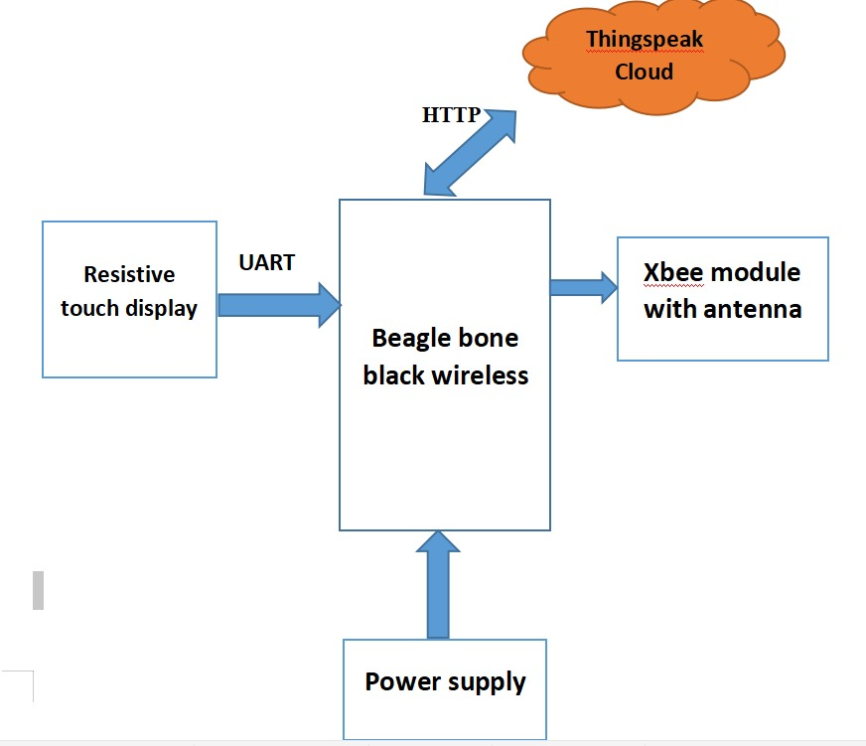
Block Diagram(Tranmitter Side)

Slide 7
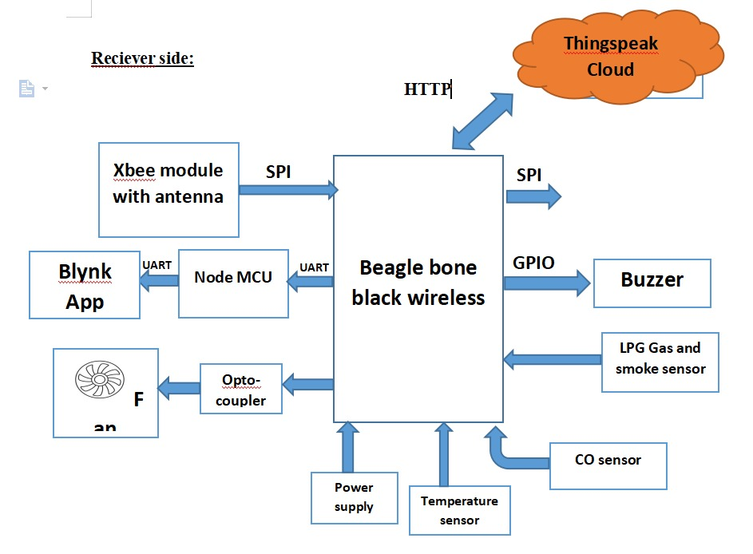
Block Diagram(Receiver Side)

Slide 8
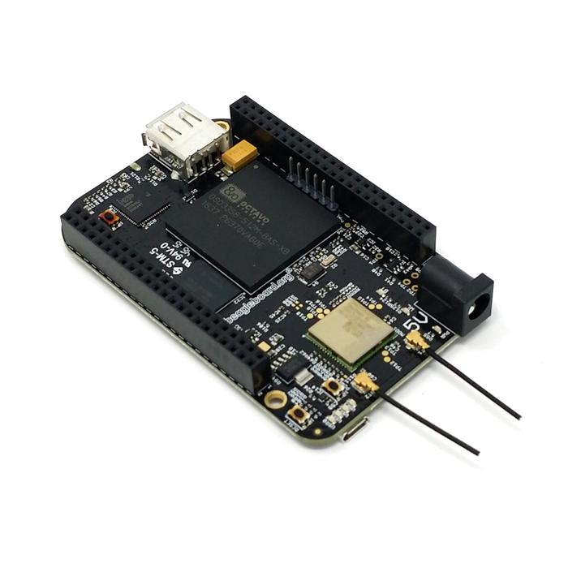
Beaglebone Black Wireless
Based on the extremely successful open-source Beaglebone Black hardware design, Beaglebone Black Wireless is a high-expansion, maker-focused, community-supported open hardware computer created by the BeagleBoard.org Foundation.

Slide 9
Specifications of BB-WI
512MB DDR3 RAM
4GB 8-bit eMMC on-board flash storage
3D graphics accelerator
NEON floating-point accelerator
2x PRU 32-bit microcontroller

Slide 10
Software compatibility of BB-WI
Debian pre-configured with Cloud9 IDE on Node.js with BoneScript library
Third-party support of Android, Ubuntu and many more upon open source Linux kernel
Non-operating-system-based peripheral support vi TI StarterWare library

Slide 11
User input/output
Reset button
Boot button
Power button
4 user configurable LEDs; WiFi and BT enable LEDs; power LED

Slide 12
Expansion header
65 digital I/O with general purpose I/O, SPI, I2C, PWM, CAN, UART, SD, quadrature encoders and more
7 analog inputs
Power in/out

Slide 13
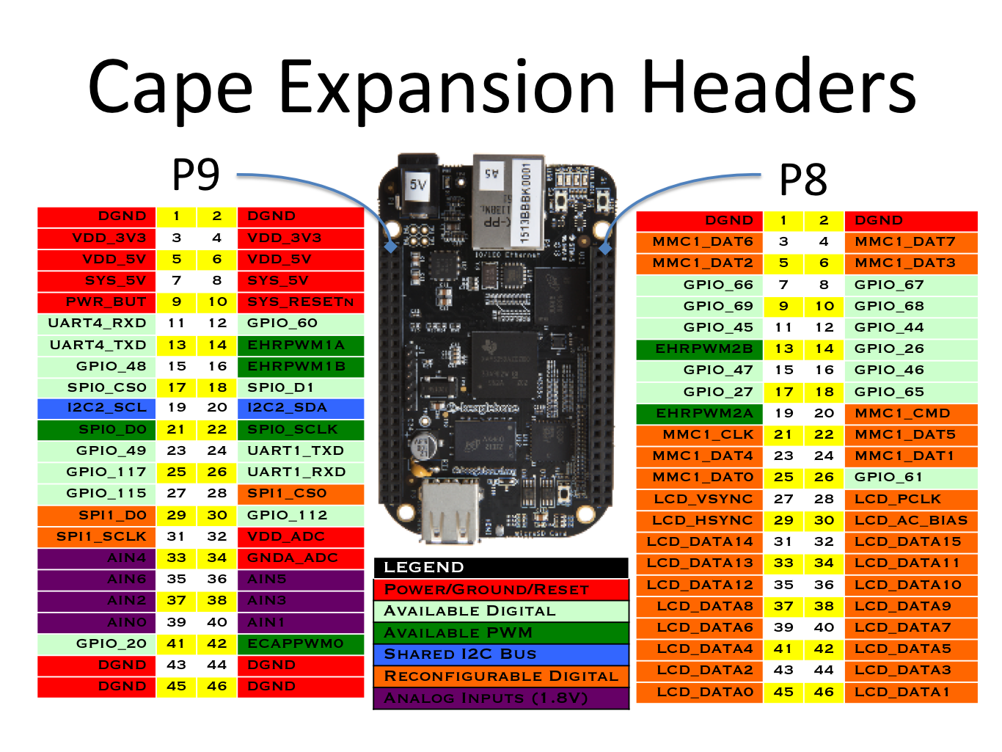
Pin Diagram of Beaglebone Black Wireless

Slide 14
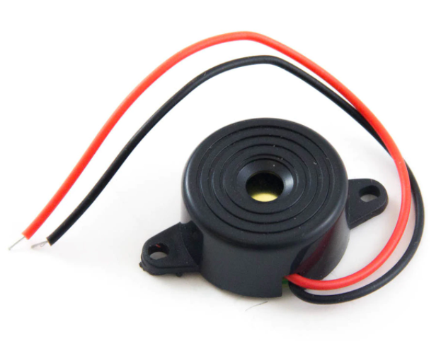
Buzzer
A buzzer or beeper is an audio signaling device, which may be mechanical ,electromechnical or piezoelectric. Typical uses of buzzers and beepers include alarm devices, timers and confirmation of user input such as a mouse click or keystroke.

Slide 15
Types of Buzzer
There are following kinds of buzzers, based on construction:
Piezoelectric buzzers
Magnetic buzzers
Electromagnetic buzzers
Mechanical buzzers
Electromechanical buzzers

Slide 16
Features of Buzzer
Rated Voltage: 6V DC
Operating Voltage: 4-8V DC
Rated current: <30mA
Sound Type: Continuous Beep
Resonant Frequency: ~2300 Hz
Small and neat sealed package
Breadboard and Perf board friendly

Slide 17
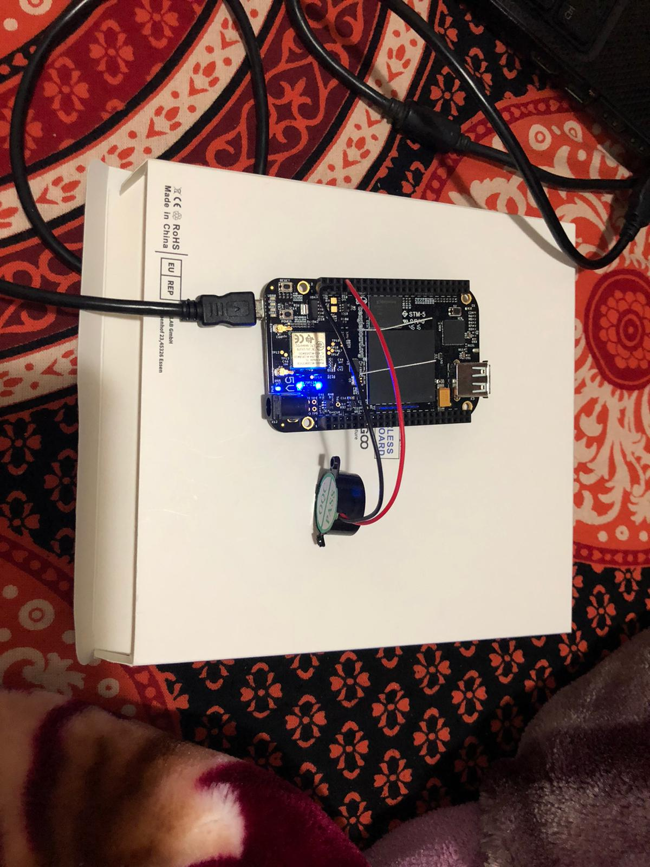
Interfacing of Buzzer with BB-WI

Slide 18
Interfacing of Buzzer with BB-WI
Red wire(+ve) of buzzer connected to 8th pin(GPIO_67) of P8 header of BB-WI.
Black wire(Ground) of buzzer connected to 2nd pin(DGND) of P8 header of BB-WI.

Slide 19
Interfacing communication protocol:GPIO
You can configure a GPIO pin as an input or output.If a pin is unconfigured, reading from the pin configures it as an input.Writing to the pin configures it as an output.
When you write 1 to a GPIO pin,the pin outputs +3.3V. When you write 0 to the pin,or do not write anything ,the pin is grounded and output 0V.

Slide 20
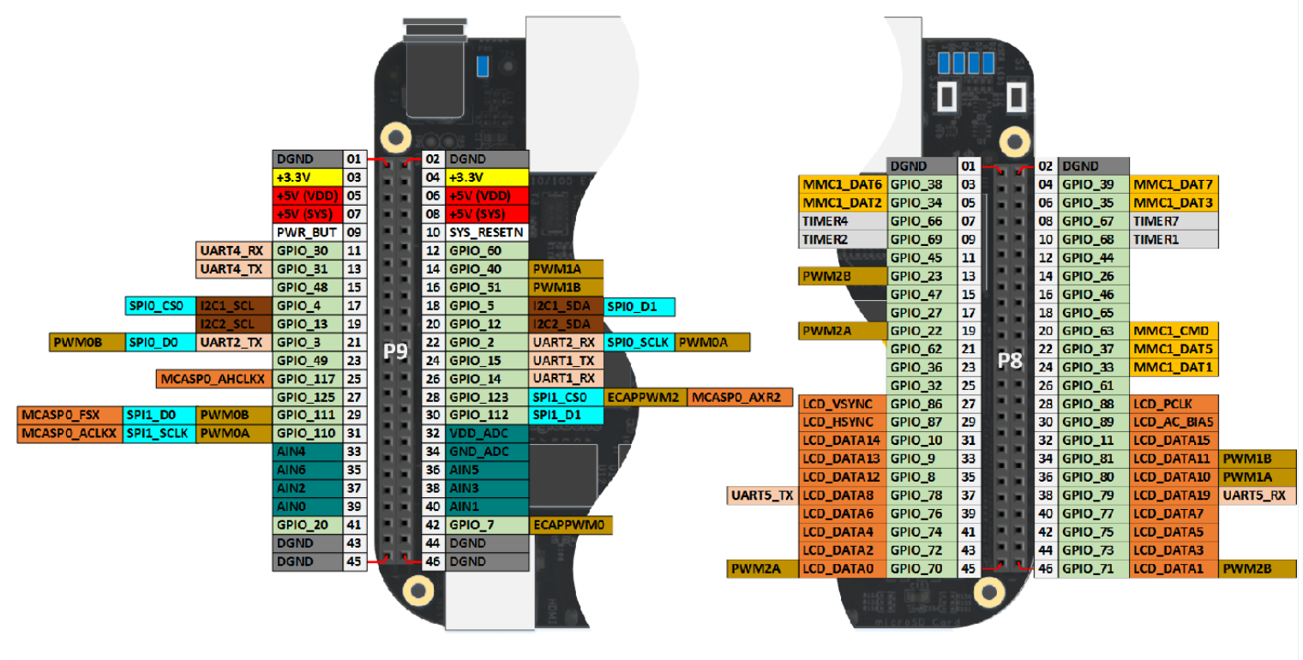
Interfacing communication protocol:GPIO

Slide 21
SSH to Beaglebone Black Wireless
Type this command in terminal and make ssh connection to BB-WI
ssh Debian@192.168.7.2
After this, put default password “temppwd”

Slide 22
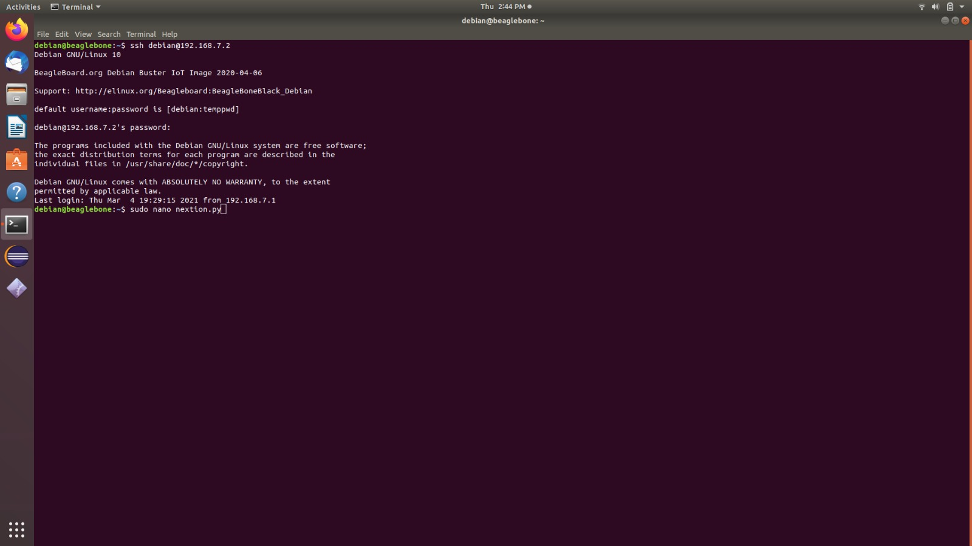
SSH to Beaglebone Black Wireless

Slide 23
Installing Library
Commands installing iobb library:
mkdir development
For creating a development folder.
cd development
To enter into development folder
cd iobb
To enter into iobb directory
make
make install

Slide 24
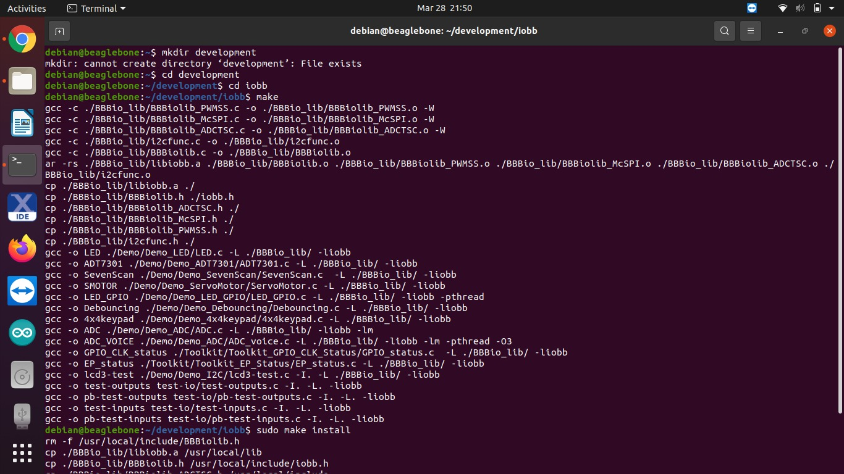
Installing Library

Slide 25
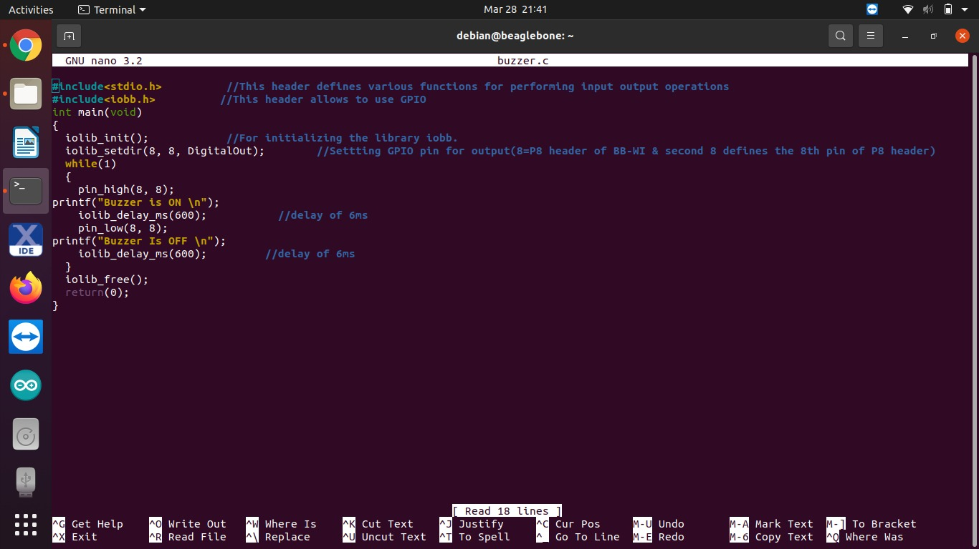
C code for interfacing

Slide 26
C code for interfacing
#include<stdio.h> //This header defines various functions for perform
#include<iobb.h> //This header allows to access GPIO
int main(void)
{
iolib_init(); //For initializing the library iobb.
iolib_setdir(8, 8, DigitalOut); //Settting GPIO pin for output(8=P8 he$
while(1)
{

Slide 27
C code for interfacing
pin_high(8, 8);
printf("Buzzer is ON \n");
iolib_delay_ms(600); //delay of 6ms
pin_low(8, 8);
printf("Buzzer Is OFF \n");
iolib_delay_ms(600); //delay of 6ms
}
iolib_free();
return(0);
}

Slide 28
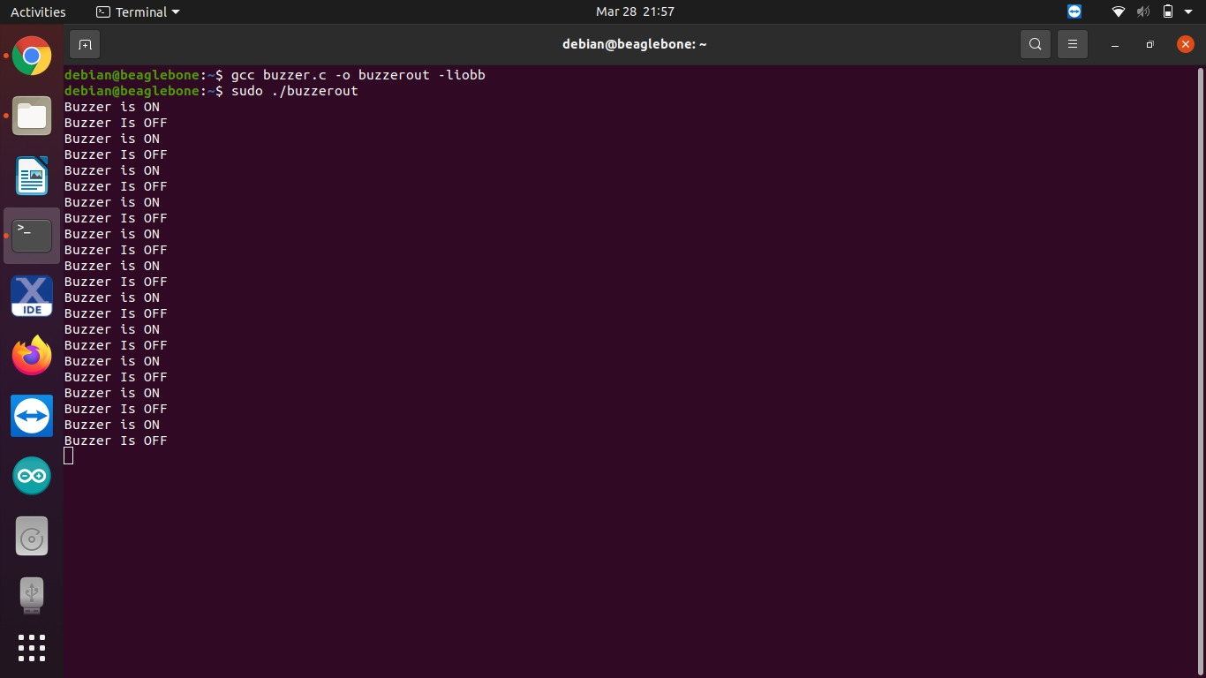
Output

Slide 29
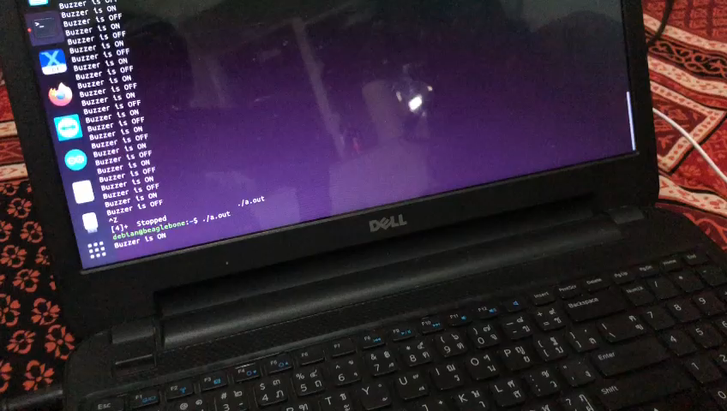
Output Video

Slide 30
References:
Interfacing:
https://www.element14.com/community/community/designcenter/single-board-computers/next-genbeaglebone/blog/2019/08/15/beaglebone-black-bbb-io-gpio-spi-and-i2c-library-for-c-2019-edition#jive_content_id_How_to_Install_the_Library
Beaglebone Black Wireless:
https://beagleboard.org/blog/2016-09-26-meet-beaglebone-black-wireless
https://www.mathworks.com/help/supportpkg/beagleboneio/ug/the-beaglebone-black-gpio-pins.html#:~:text=When%20you%20read%20the%20GPIO,of%20the%20pin%20is%201%20

Slide 31
References:
Installing the Library:
https://www.element14.com/community/community/designcenter/single-board-computers/next-genbeaglebone/blog/2019/08/15/beaglebone-black-bbb-io-gpio-spi-and-i2c-library-for-c-2019-edition#jive_content_id_How_to_Install_the_Library
Buzzer:
https://www.quisure.com/blog/faq/what-is-a-buzzer
https://www.engineersgarage.com/tech-articles/buzzers-types-transducer-indicator-piezo-magnetic/
https://components101.com/misc/buzzer-pinout-working-datasheet

